Slide 1

IoT-BASED SMART BANDAGES FOR CONTINUOUS MONITORING OF CHRONIC WOUNDS
SUBMITTED BY
LINGESH KUMAR K [210421121024]
Department of Biomedical Engineering
Chennai Institute Of Technology
GUIDED BY
Mrs.Sasimeklaa M M ,M.E.,
Assistant Professor,
Department of Biomedical Engineering

Slide 2
PROBLEM STATEMENT
MAIN PROBLEM STATEMENT
Smart bandages have the potential to revolutionize wound care by incorporating technology to monitor and assist in the healing process. However, they also come with certain challenges and limitations.
Low battery span
Connectivity issues
Comfort of wearability
Limited availability

Slide 3
LITERATURE REVIEW
Sl. No | Title of the Paper | Authors | Name of the Journal, Year, Volume, Issue | Observation
01 | Smart Bandage for Monitoring and Treatment of Chronic Wounds | Pooria Mostafalu, Ali Tamayol, Gita Kiaee | Volume14, Issue33 August 16, 2018 1703509 | The presented smart wound dressing, equipped with real-time monitoring sensors and on-demand drug delivery, holds promise for revolutionizing chronic wound treatment.
02 | Wireless Flexible Smart Bandage for Continuous Monitoring of Wound Oxygenation | Pooria Mostafalu; William Lenk; Mehmet R. Dokmeci; Babak Ziaie | Volume: 9, Issue: 5, October 2015 | This innovation holds the potential to significantly improve wound healing outcomes by establishing a feedback loop for optimized, patient-specific treatment.
03 | Early detection and monitoring of chronic wounds using low-cost, omniphobic paper-based smart bandages | Aniket Pal , Debkalpa Goswami , Hugo E. Cuellar, Beatriz Castro | Volume 117, 15 October 2018 | The development of single-use omniphobic paper-based smart bandages (OPSBs) and a reusable wearable potentiostat represents a cost-effective

Slide 4
LITERATURE REVIEW
Sl. No | Title of the Paper | Authors | Name of the Journal, Year, Volume, Issue | Observation
04 | Smart Bandage With Wireless Strain and Temperature Sensors and Batteryless NFC Tag | Pablo Escobedo, Mitradip Bhattacharjee, Fatemeh | Volume: 8, Issue: 6, 15 March 2021 | This article introduces an innovative smart bandage featuring wireless strain and temperature sensors, leveraging conductive PEDOT:PSS polymer, with exceptional sensitivity and responsiveness.
05 | Wearable Smart Bandage-Based Bio-Sensors | Arie Levin,Shu Gong,Wenlong Cheng | 6 April 2023 | This review explores the convergence of traditional bandages and emerging wearable electronics, positioning bandages as the foundation for wearable bioelectronics.
06 | Battery Free Smart Bandage based on NFC RFID Technology | Yi Li,Neil Grabham, Abiodun Komolafe, John Tudor | (FLEPS)16-19 August 2020 | This research introduces a groundbreaking wireless and battery-free smart bandage, powered by Radio Frequency (RF) energy through NFC RFID

Slide 5
LITERATURE REVIEW
Sl. No | Title of the Paper | Authors | Name of the Journal, Year, Volume, Issue | Observation
07 | Photonic smart bandage for wound healing assessment | Arnaldo Leal-Junior, Jingjing Guo, Rui Min | Vol. 9, Issue 3,February 5, 2021 | This research introduces a groundbreaking smart wound dressing featuring an embedded optical fiber capable of assessing both wound pH and pressure, addressing the pressing need for effective chronic wound management.
08 | New Developments in Smart Bandage Technologies for Wound Diagnostics | Anna McLister, Jolene McHugh, Jill Cundell | Volume28, Issue27, July 20, 2016 | The need for wound pH assessment tools is emphasized due to their potential to enhance clinical outcomes by aiding in early complication detection, particularly infections, in wound care.
09 | Smart wound dressings for wound healing | Ruonan Dong, Baolin Guo | Volume 41 ,December 2021 | Smart wound dressings, equipped with sensors and responsive materials, are emerging as promising tools to enhance wound healing

Slide 6
LITERATURE REVIEW
Sl. No | Title of the Paper | Authors | Name of the Journal, Year, Volume, Issue | Observation
10 | Smart Bandages: The Future of Wound Care | Hossein Derakhsha Sara Saheb Kashaf, Fariba Aghabaglu | VOLUME 36, ISSUE 12, DECEMBER 2018 | The field of wound healing presents a substantial commercial opportunity, yet it faces significant challenges. Smart systems, with their sensing, responding, and reporting capabilities, hold promise in addressing these challenges, particularly for chronic wounds.

Slide 7
EXISTING SYSTEM
The smart bandage, developed by researchers at the California Institute of Technology (Caltech), integrates biosensors, drug-loaded hydrogels, electrical stimulation modules, and wireless communication.
It is designed to maintain contact with and adhere to the skin using a soft, stretchable polymer.
The bandage includes biosensors that monitor wound biomarkers in the exudate, providing real-time information about the wound's status.
Data collected by the bandage is wirelessly transmitted to a smartphone or tablet for review by healthcare professionals.

Slide 8
PROPOSED SYSTEM
Project Overview:
We propose the development of IoT-based smart bandages that offer an unprecedented combination of long-lasting battery life, top-notch connectivity, and exceptional comfort for patients. This innovation will address critical needs in the healthcare industry by enhancing patient care and monitoring.
Objectives:
The primary objectives of this project are as follows:
Design and develop IoT-enabled smart bandages with extended battery life.
Ensure seamless connectivity for real-time data transmission to healthcare providers.
Prioritize patient comfort and wearability to encourage prolonged use.
Enhance the overall patient experience during wound care and monitoring.

Slide 9
PROPOSED SYSTEM
Key Features and Innovations:
Long Battery Life: Incorporation of advanced energy-efficient components and power management algorithms to extend the bandage's battery life significantly.
Best Connectivity: Integration of cutting-edge IoT technologies, such as low-power Bluetooth, for reliable and continuous data transmission to healthcare professionals.
Comfort of Wearability: Utilization of soft, breathable, and hypoallergenic materials to ensure comfort during long-term wear. Ergonomic design to minimize discomfort and skin irritation.
Methodology:
The development process will encompass the following steps,
Research and development of energy-efficient IoT sensors and connectivity modules.
Prototyping and testing of smart bandages with focus groups for user feedback.
Iterative design improvements based on user feedback.
Production and quality assurance of smart bandages.

Slide 10
WORKING
Sensors: Smart bandages are equipped with various sensors that can detect and measure specific wound-related parameters. These sensors can include:
Temperature Sensors: These sensors measure the temperature of the wound and the surrounding tissue. Elevated temperatures can indicate inflammation or infection.
Moisture Sensors: Moisture sensors detect the moisture level of the wound bed. Excessive moisture can be a sign of infection or poor wound healing.
pH Sensors: pH sensors measure the acidity or alkalinity of the wound. Abnormal pH levels can indicate infection or an unfavorable wound environment.
Pressure Sensors: Some smart bandages include pressure sensors to monitor the pressure on the wound. This is particularly important for patients at risk of developing pressure ulcers.
Gas Sensors: In some advanced smart bandages, gas sensors can measure oxygen and carbon dioxide levels in the wound area, providing insights into tissue oxygenation.
Data Collection: The sensors continuously collect data from the wound and its surroundings. This data may include temperature readings, moisture levels, pH values, and other relevant metrics.

Slide 11
WORKING
Data Processing: The collected data is processed within the smart bandage, often using microcontrollers or other embedded computing devices. This processing may involve data analysis to detect anomalies or trends in the wound condition.
Wireless Connectivity: Smart bandages are typically equipped with wireless communication capabilities, such as Bluetooth, Wi-Fi, or cellular connectivity. This allows them to transmit the collected data to external devices or a central monitoring system.
Data Transmission: The processed data is transmitted in real-time to a designated recipient, which can include healthcare professionals, caregivers, or the patient. This data can be sent to a mobile app, a secure web portal, or a hospital's electronic health records system.
Alerts and Notifications: When the smart bandage detects any abnormalities or concerning changes in the wound condition (e.g., signs of infection, inadequate healing progress), it can trigger automatic alerts and notifications. These alerts can be sent to healthcare providers or the patient, prompting timely intervention.

Slide 12
WORKING
Patient Engagement: Many smart bandages are designed to engage patients in their own wound care. Patients can access the data through a mobile app or a web portal, allowing them to monitor their progress, receive reminders for dressing changes or medication, and communicate with healthcare professionals.
Remote Monitoring: Healthcare providers can remotely monitor the patient's wound condition through the data transmitted by the smart bandage. This enables timely interventions and reduces the need for frequent in-person visits.
Data Storage and Analysis: Collected data may also be stored for future reference and analysis. Trends in wound healing can be identified, and treatment plans can be adjusted based on data-driven insights.
Smart bandages can significantly improve wound care by providing continuous monitoring and early detection of complications. They empower both patients and healthcare providers with valuable information to optimize the healing process and reduce the risk of infections and complications.

Slide 13
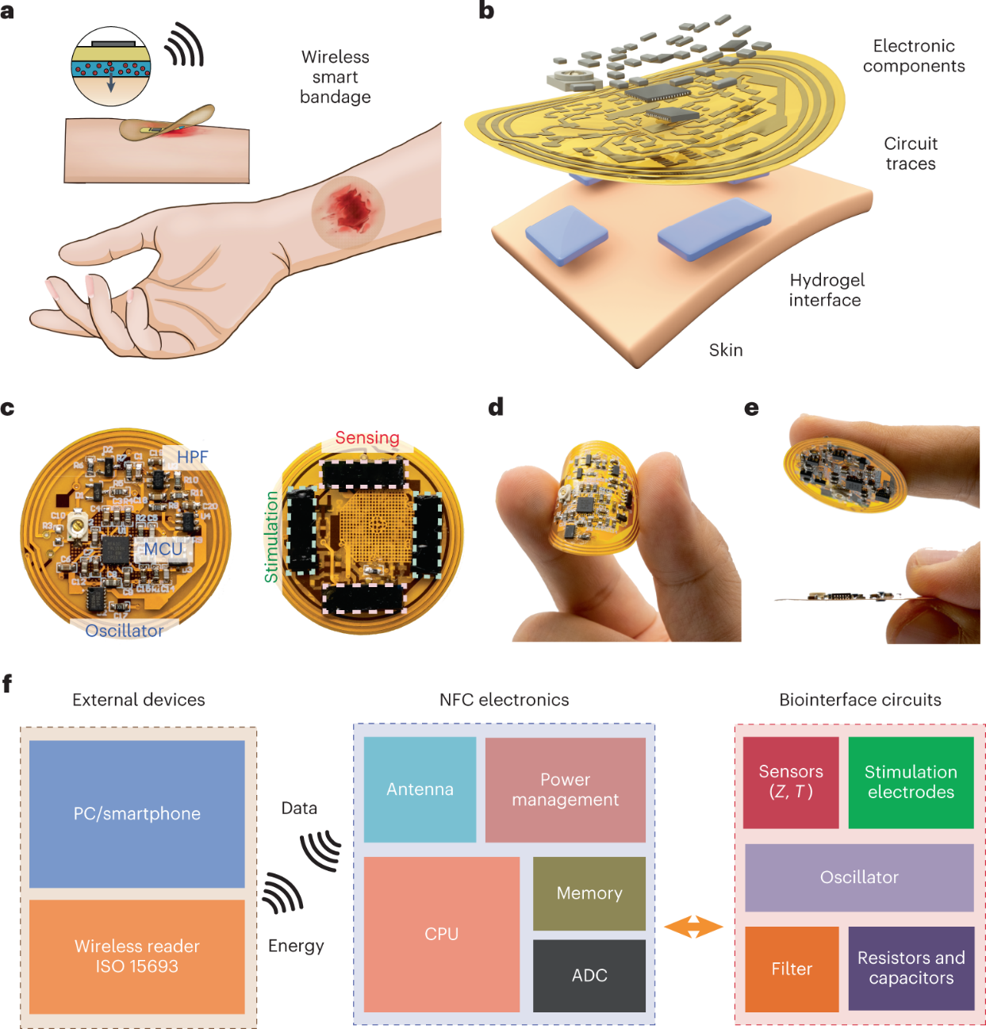
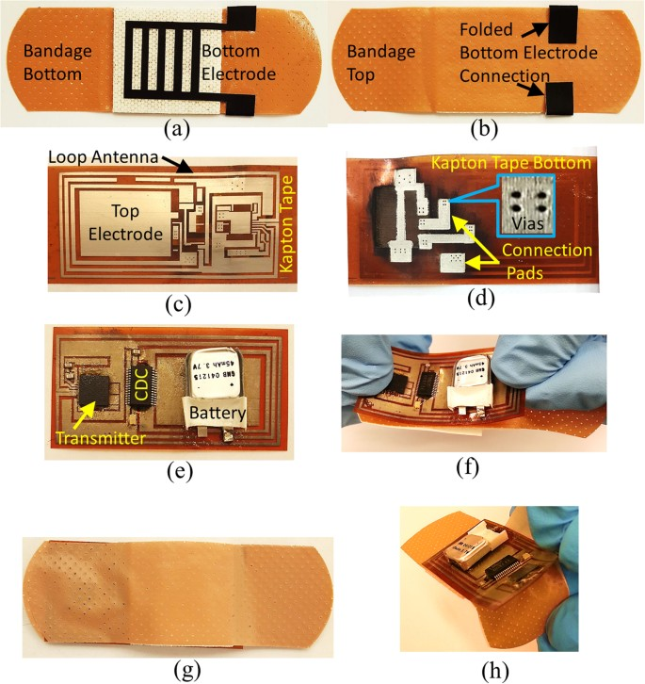
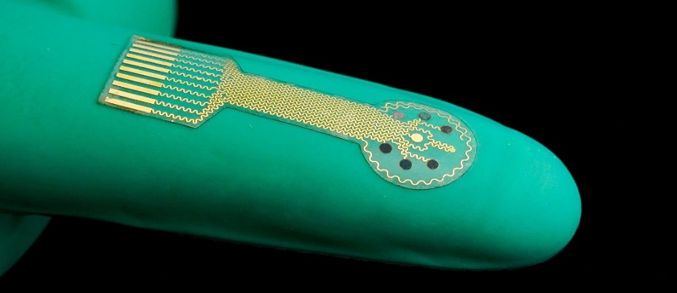
PHOTOSNAP OF PROJECT

Slide 14
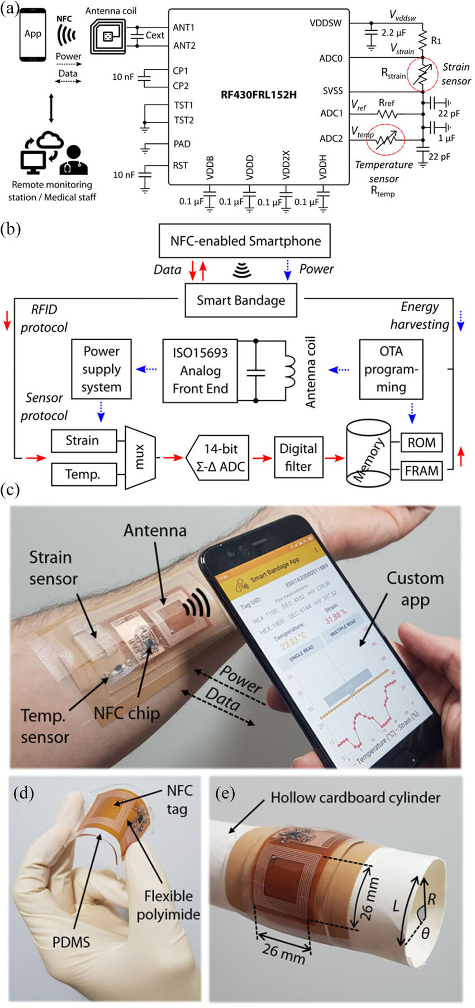
CIRCUIT DIAGRAM
NOTE: This Circuit is not related to Arduino

Slide 15


